Slide 1



Ready Player One!
Eliciting Diverse Knowledge Using A Configurable Game
Agathe Balayn*, Gaole He*, Andrea Hu*, Jie Yang, Ujwal Gadiraju
Notes:
Hello everyone, I’m Gaole He. The paper is in collaboration with Agathe Balayn, Andrea Hu, Jie Yang and Ujwal Gadiraju.
The authors of this paper come from web information system lab of TU Delft.
Today, I’ll show you our work on diverse knowledge elicitation using a game with a purpose.

Slide 2


Motivation: AI Needs Plural Commonsense Knowledge
Input:
Choices:
Where are floors kept clean for holy purposes?
restaurant B. apartment C. synagogue D. carpet
Knowledge tuples:
(synagogue, restaurant, isA, religious place)
(restaurant, isA, holy place)
Output:
restaurant
synagogue
Discriminative knowledge
Negative knowledge
Notes:
In real world applications, AI systems need plural types of commonsense knowledge.
For example, to answer this question, we need the knowledge that restaurant is not a holy place, while synagogue is.
While existing commonsense knowledge base store relational facts about the world, the discriminative knowledge and
negative knowledge (restaurant is not a holy place) is typically absent from the existing large-scale knowledge base.

Slide 3
Plural Commonsense Knowledge
Generative knowledge
Format: +/- <concept, relation, description>
Discriminative Knowledge
Format: +/- <concept1, concept2, relation, description>
positive case: +<concept1, relation, description> and -<concept2, relation, description>
negative case, concept1 and concept2 can’t be discriminated with <relation, description>
 | Sign | Example
Generative | positive | + (lamp, HasProperty, makes light),
 | negative | - (dishwasher, UsedFor, preserving food)
Discriminative | positive | + (fish, octopus, HasA, fins)
 | negative | - (human, lion, IsA, mammal)
Notes:
In this paper, the collected knowledge tuples fall into generative and discriminative category, meanwhile contains positive and negative signs.
The generative knowledge describes the real world fact in the format of <subject, predicate, object>. The sign here indicates whether the attribute holds or not in real world
Another type of knowledge is discriminative knowledge which describes whether the attribute can discriminate two concepts.
The sign then indicate whether the two concepts can be discriminated with such attribute.
For example

Slide 4



Idea: Gathering Different Types of Knowledge at Scale
Needs
Negative knowledge
Discriminative knowledge
Opportunities
Games with a purpose
Scale from crowdsourcing
Research gaps
Understanding of the types of knowledge that can be gathered
Evolving requirements of downstream AI tasks
Our solution
FindItOut, a configurable GWAP
AI: neuro-symbolic AI, ML debugging
Knowledge engineering
Human computation
Notes:
Commonsense knowledge may have renewed usage in the context of AI, such as improving neuro-symbolic AI and debugging machine learning models.
We also have another paper about machine learning debugging presented in the knowledge track this afternoon.
In these usages, we need plural types of knowledge, such as negative and discriminative knowledge, which are typically absent from existing large scale knowledge base.
With the recent trends in human computation, there are new opportunities to collect such knowledge at scale.
Game with a purpose is an effective and enjoyable approach to collect commonsense knowledge from human players.
However, little is currently understood about the types of knowledge that can be gathered using existing knowledge elicitation methods.
Moreover, these methods fall short of meeting the evolving requirements of several downstream AI tasks.
Inspired by famous game “guesswho”, we developed a novel game with a purpose, ‘FindItOut’, to elicit different types of knowledge from human players through easily configurable game mechanics.

Slide 5

Empirical Evaluation &
Experiments
Game Procedure &
Knowledge Collection
Notes:
First, I will show you our approach FindItOut, about the game procedure and how we collect knowledge from this game.

Slide 6
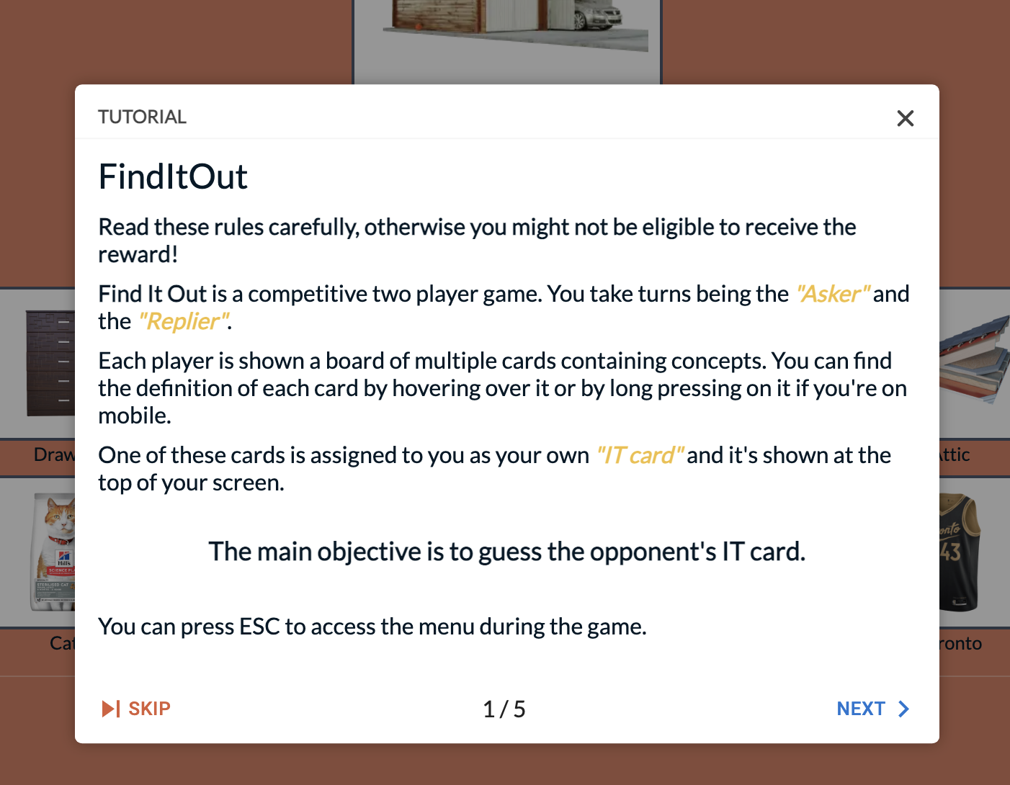
FindItOut (1)
Tutorial
Notes:
In the game, we first provide a detailed tutorial about the game, including rules and design features to all participants.

Slide 7
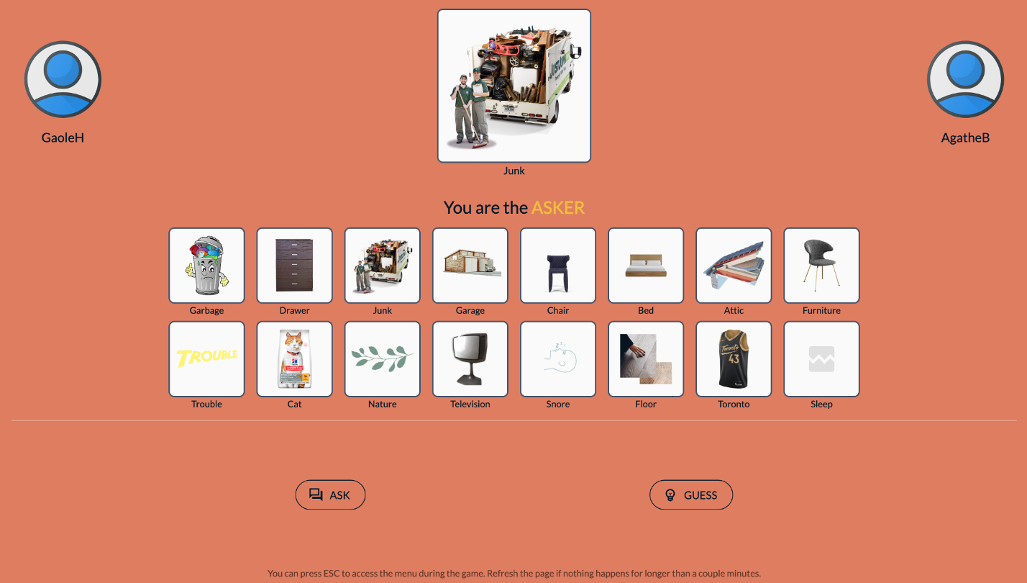
FindItOut (2)
GaoleH needs to identify the opponent’s target card
Notes:
FindItOut is a two-player competitive game. The objective of the game for each player is to guess the opponent’s target card.
Each player has a target card, which is at the top middle part of his interface.
In this case, Junk is GaoleH’s target card.

Slide 8
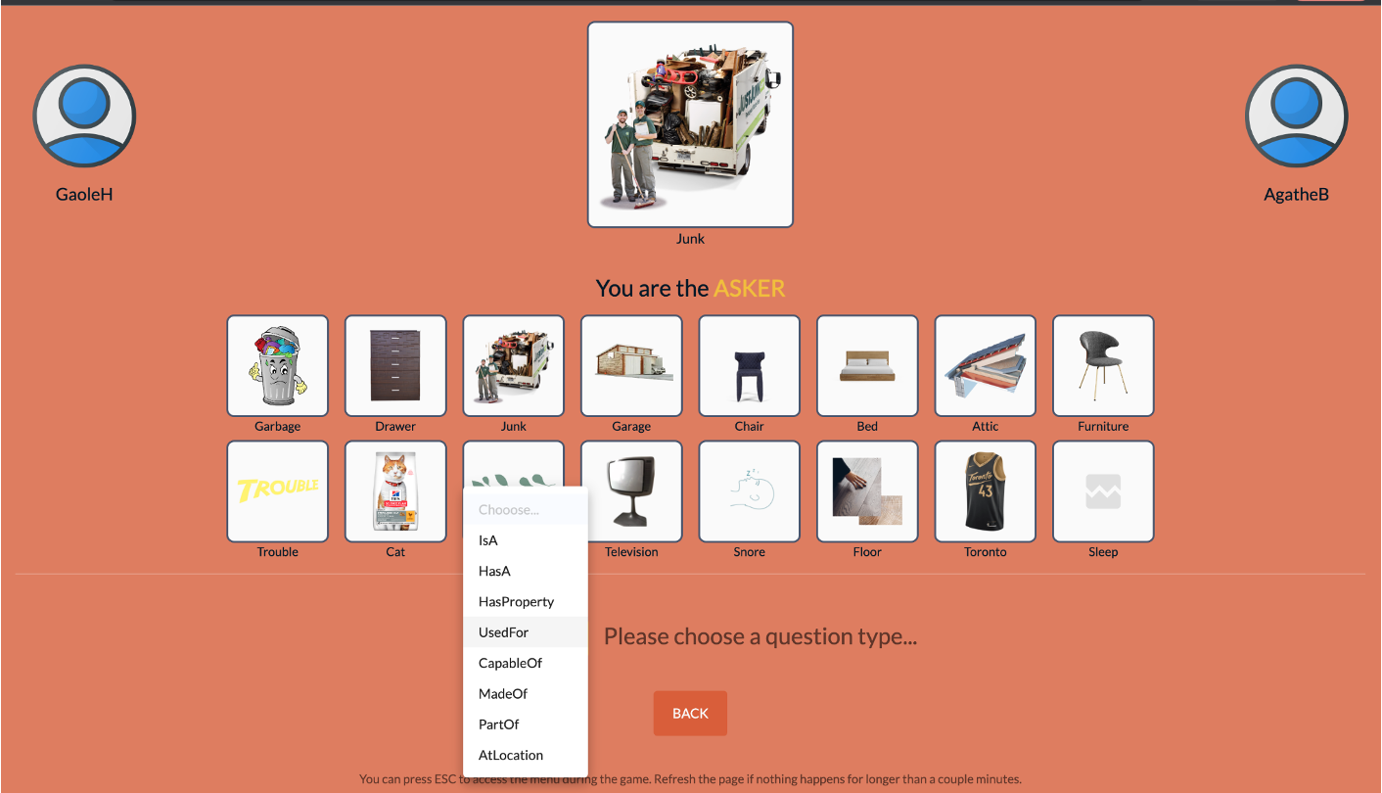
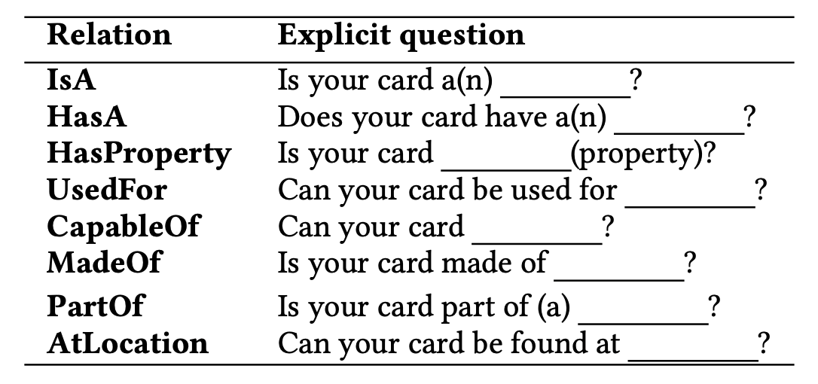
FindItOut (3)
GaoleH creates a question by selecting a template
Notes:
To guess the opponent’s target card, each turn one player ask questions based on provided relational templates. (in this slide, GaoleH plays the role ASKer)
In our game, we provide 8 relation-based templates which can be found in the bottom part of this slide.
All relations in FindItOut are selected from ConceptNet.

Slide 9
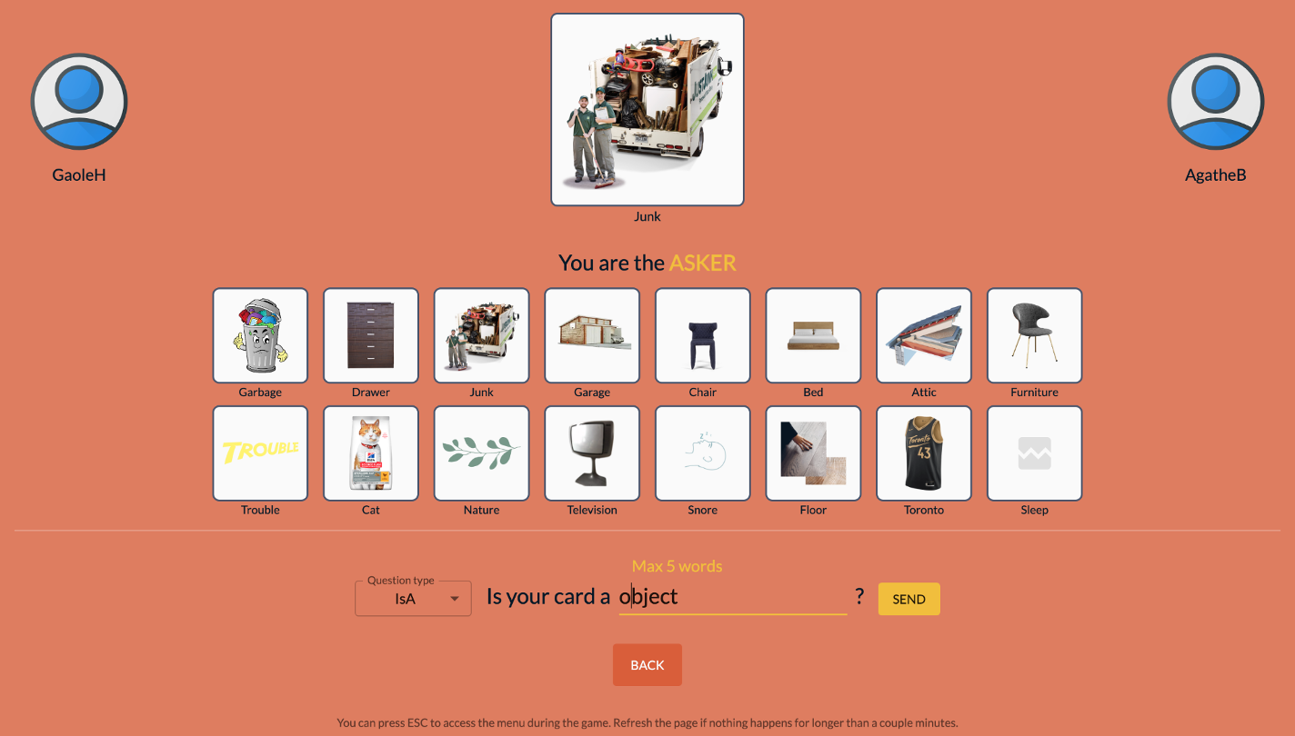
FindItOut (4)
GaoleH creates a question by inputting free text
Notes:
With the selected template, GaoleH creates a question by inputting free text.

Slide 10
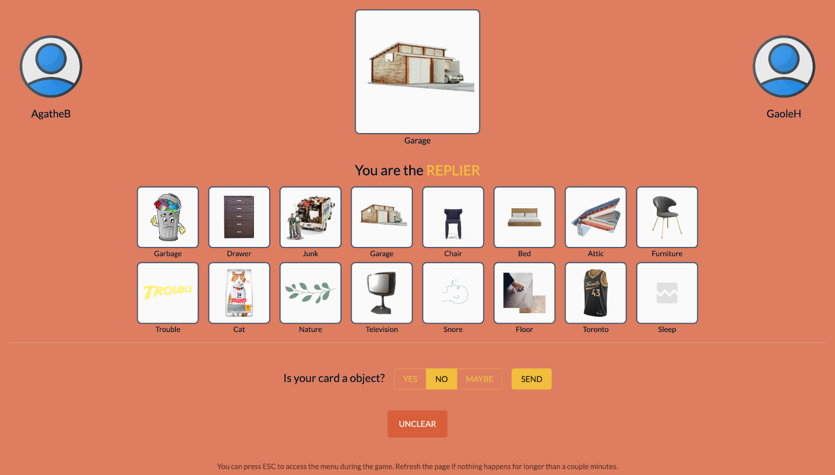
FindItOut (5)
AgatheB answers GaoleH’s question
Notes:
After GaoleH submit the question, the opponent AgatheB will receive the question.
As this slide show, AgatheB will respond to the question “Is your card an object” according to her own targe card “Garage”.
We have three options: Yes, NO and Maybe which corresponds to the positive, negative and uncertain answer.
If the replier feels that the question is not clear to answer, she can also respond with “UNCLEAR” and then the asker need to rephrase his question.

Slide 11
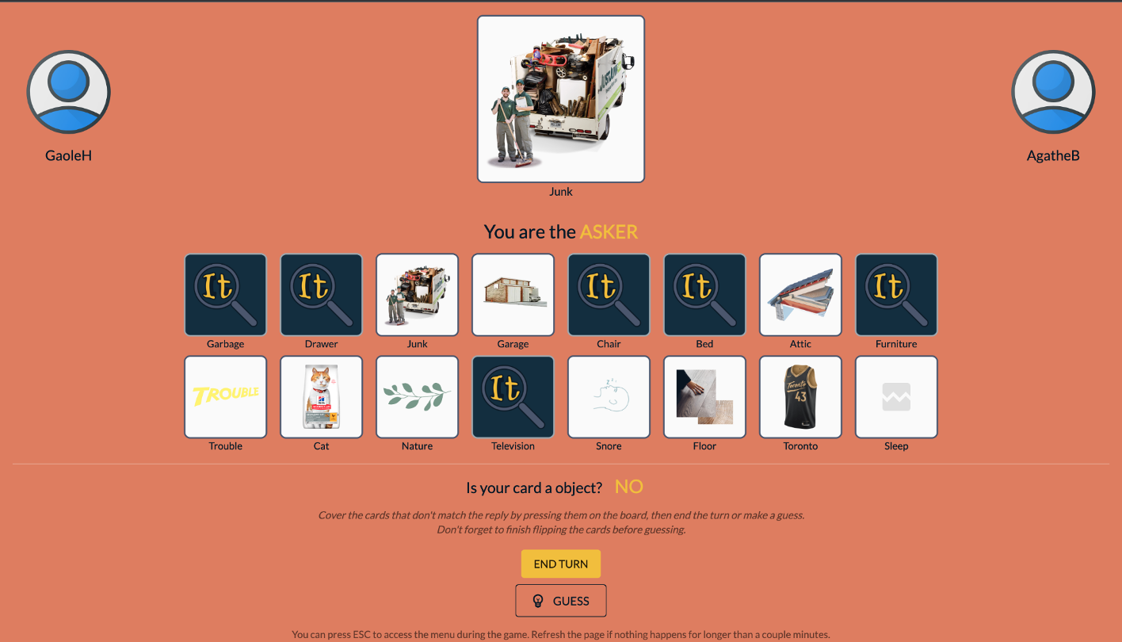
FindItOut (6)
GaoleH receives the answer and flips corresponding cards
Notes:
After opponent send back the answer, Asker can discard some candidate concepts with flipping the card.
Then he can choose “End Turn” or “Guess”.
If he choose “End Turn”, GaoleH and AgatheB will switch their roles and take another turn.

Slide 12
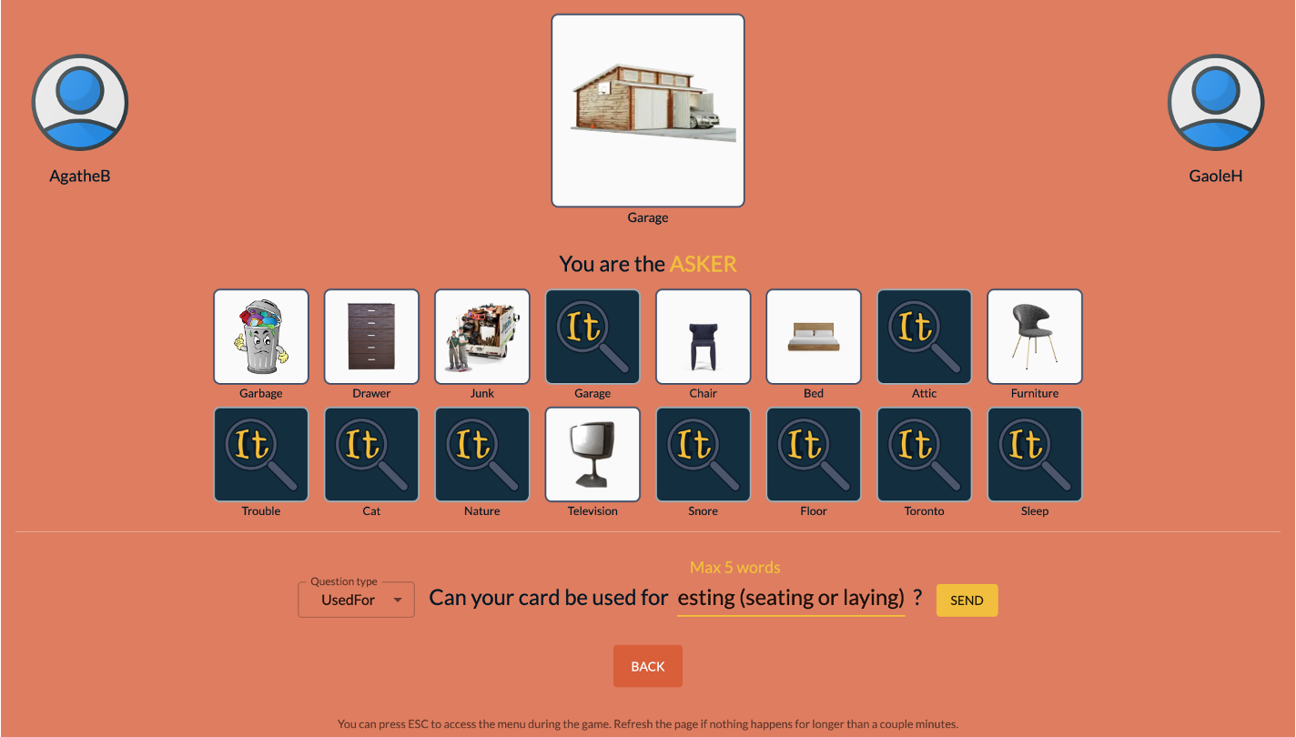
FindItOut (7)
Switch Role.
It is now AgatheB’s turn
Notes:
Now, it’s AgatheB’s turn to ask questions and reduce candidates in the game board.

Slide 13
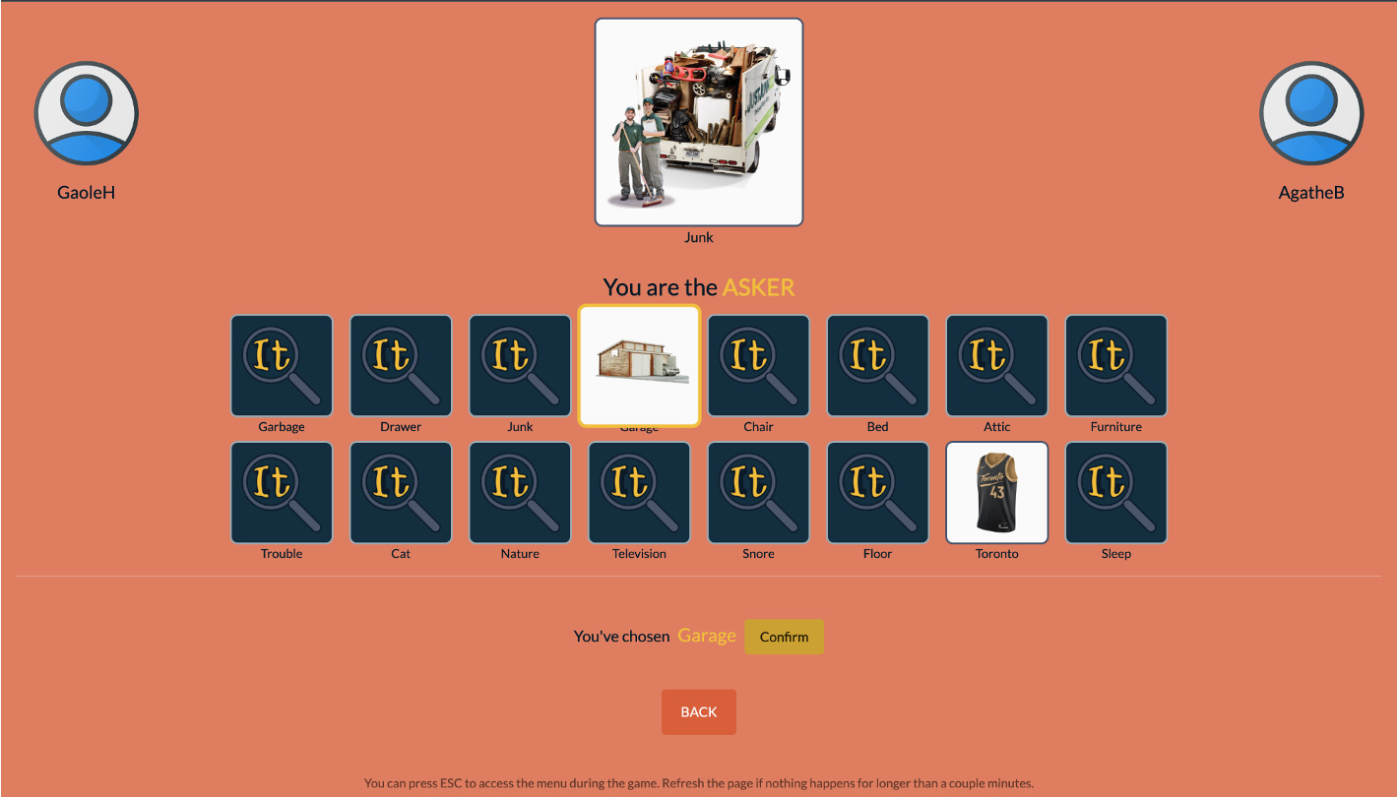
FindItOut (8)
After a few rounds, GaoleH is making a guess!
Notes:
After a few rounds, the Asker can make a guess to end the game.
If he correctly guess the opponent’s target card, he will win this game.
Meanwhile, a wrong guess leads to the failure.

Slide 14
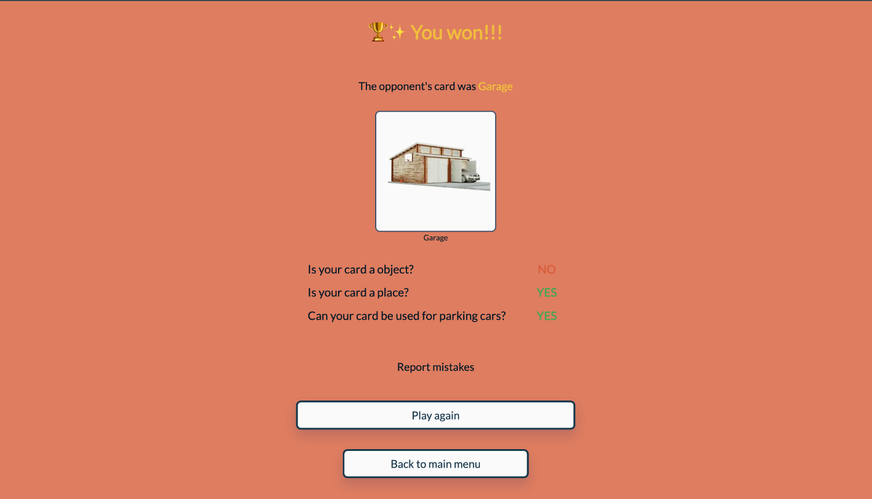
FindItOut (9)
GaoleH won as he made the correct guess!
Notes:
In this slide, GaoleH win the game, and have an interaction history from his side.
If the opponent lies during the game, he can report it.

Slide 15
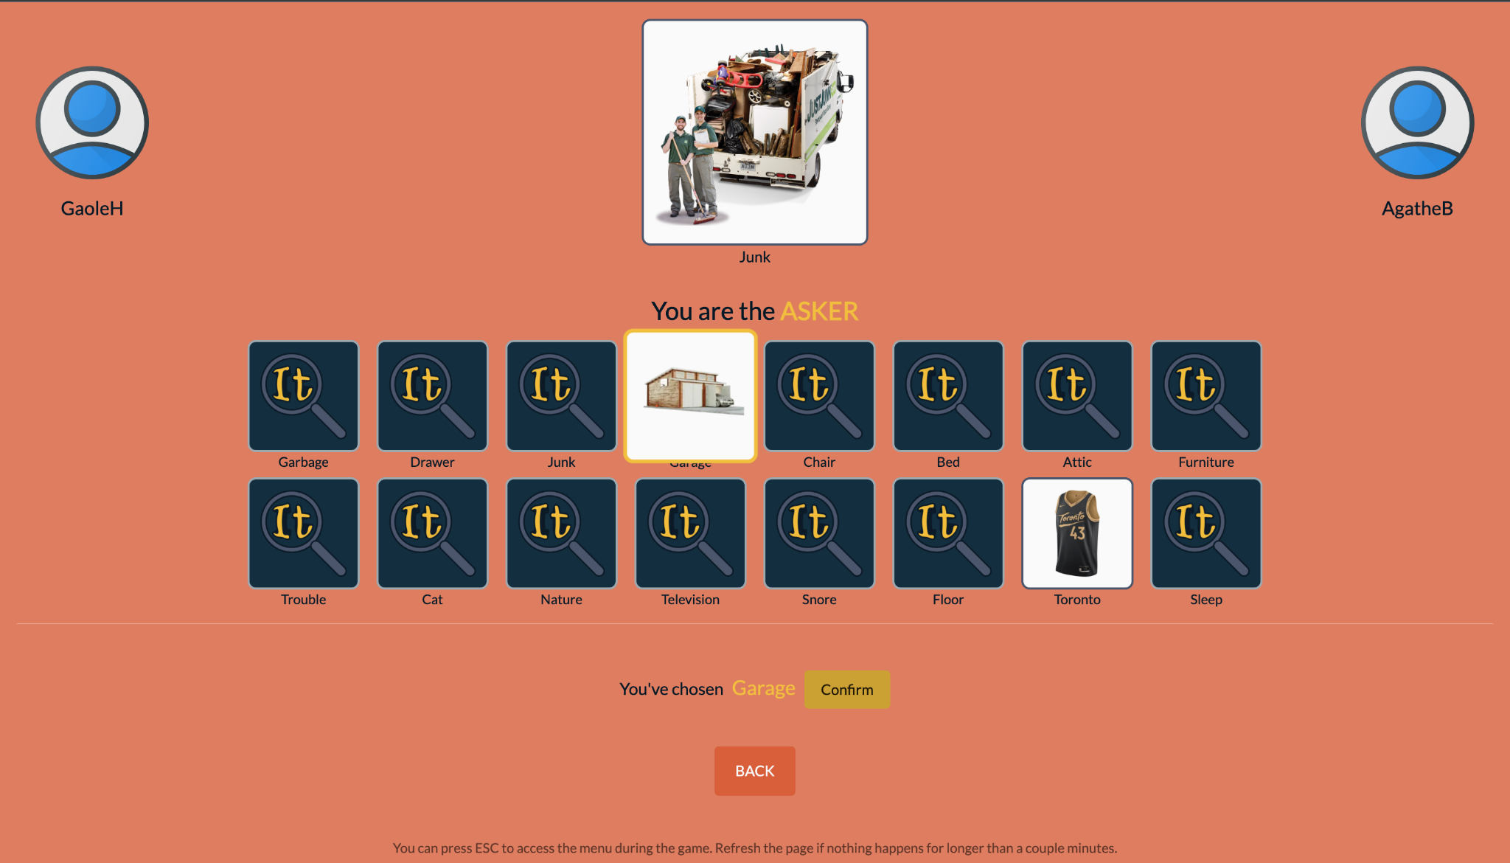
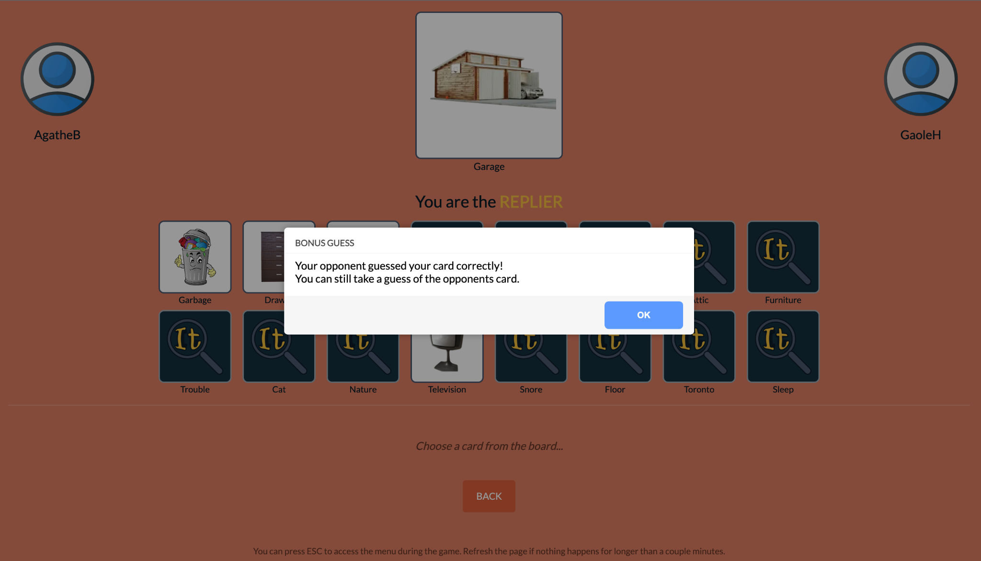
Quality Control & Mechanics
Varying game difficulty through game board (number and type of cards)
Providing fair chances to win
Notes:
To guarantee the quality of collected commonsense knowledge, we have following feature designs
First, we provide varying game difficulty through the number and types of cards in game board.
In our experience, the board which contain abstract concept like (fun, happiness) becomes more challenging compared to game board composed of concrete daily items.
To ensure both players have equal chance to win,
if the opponent make a correct guess, player can still make a guess and have the chance to win and get bonus from our study.

Slide 16
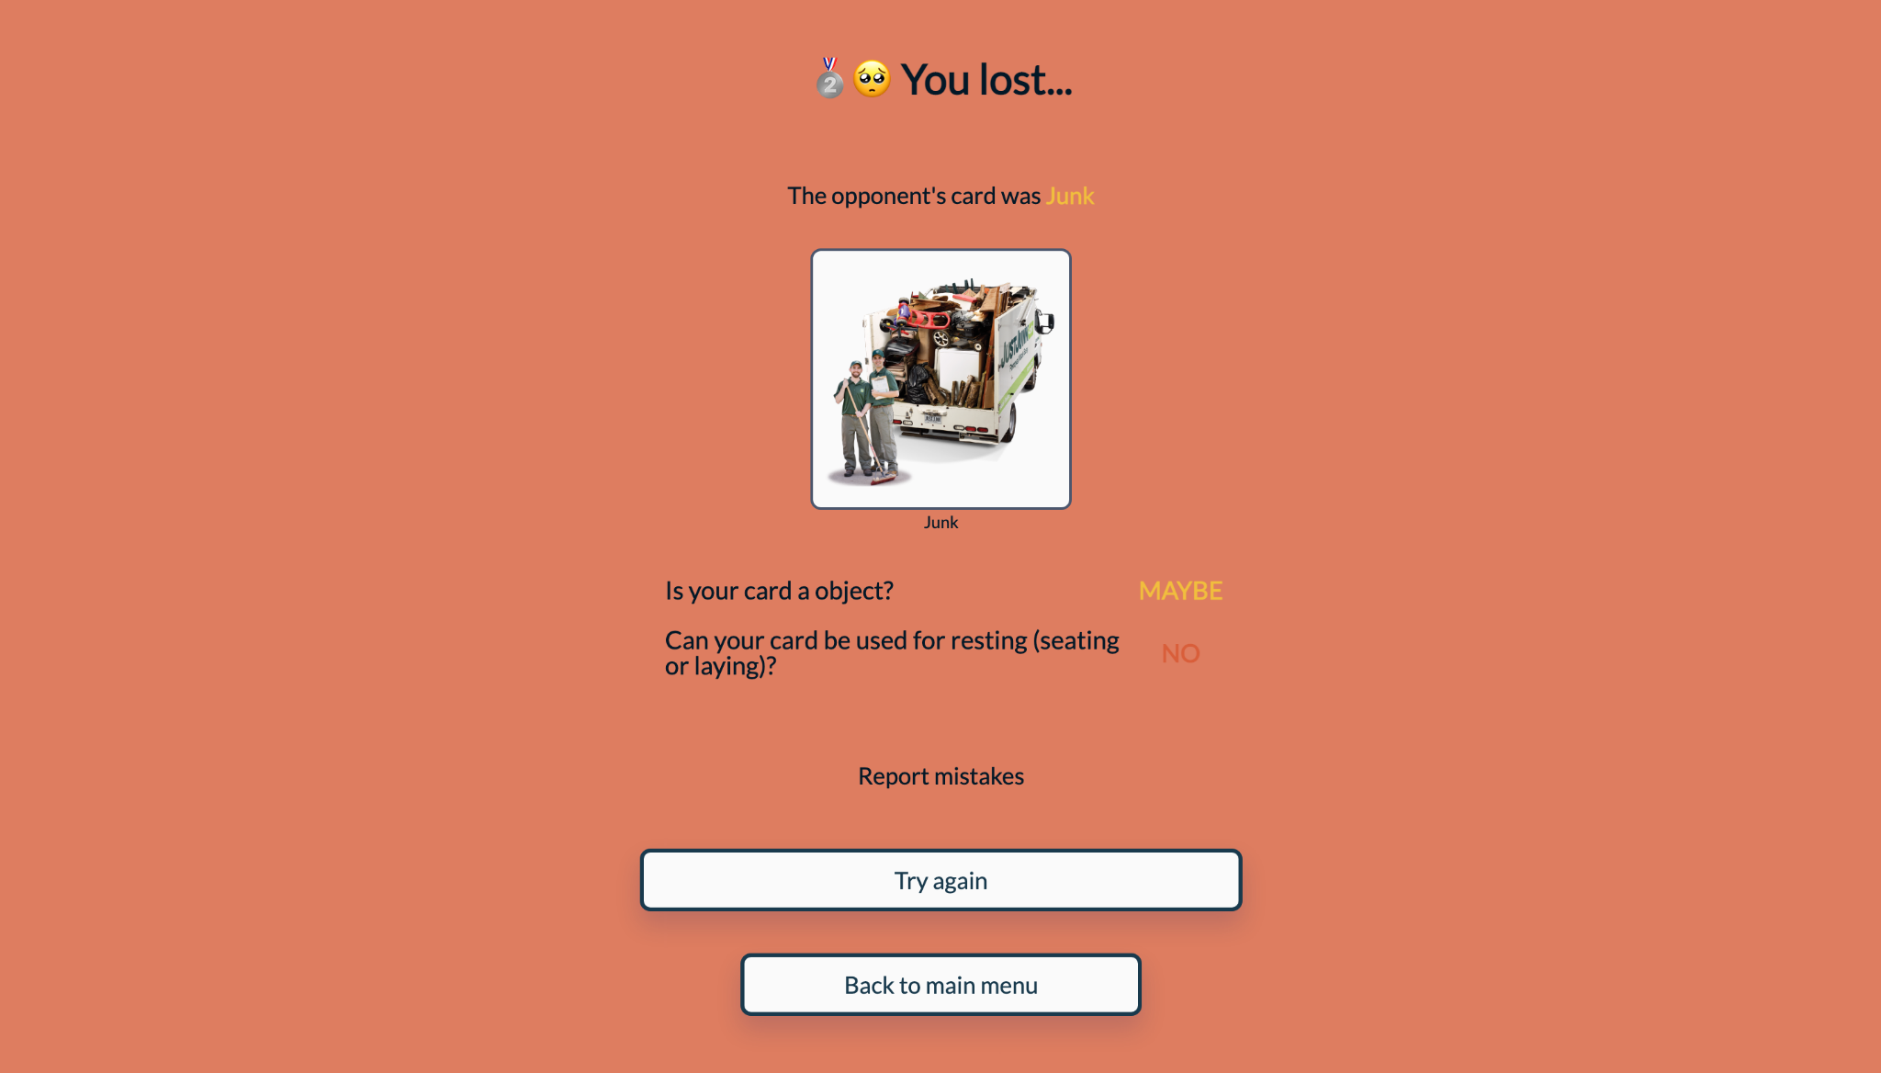
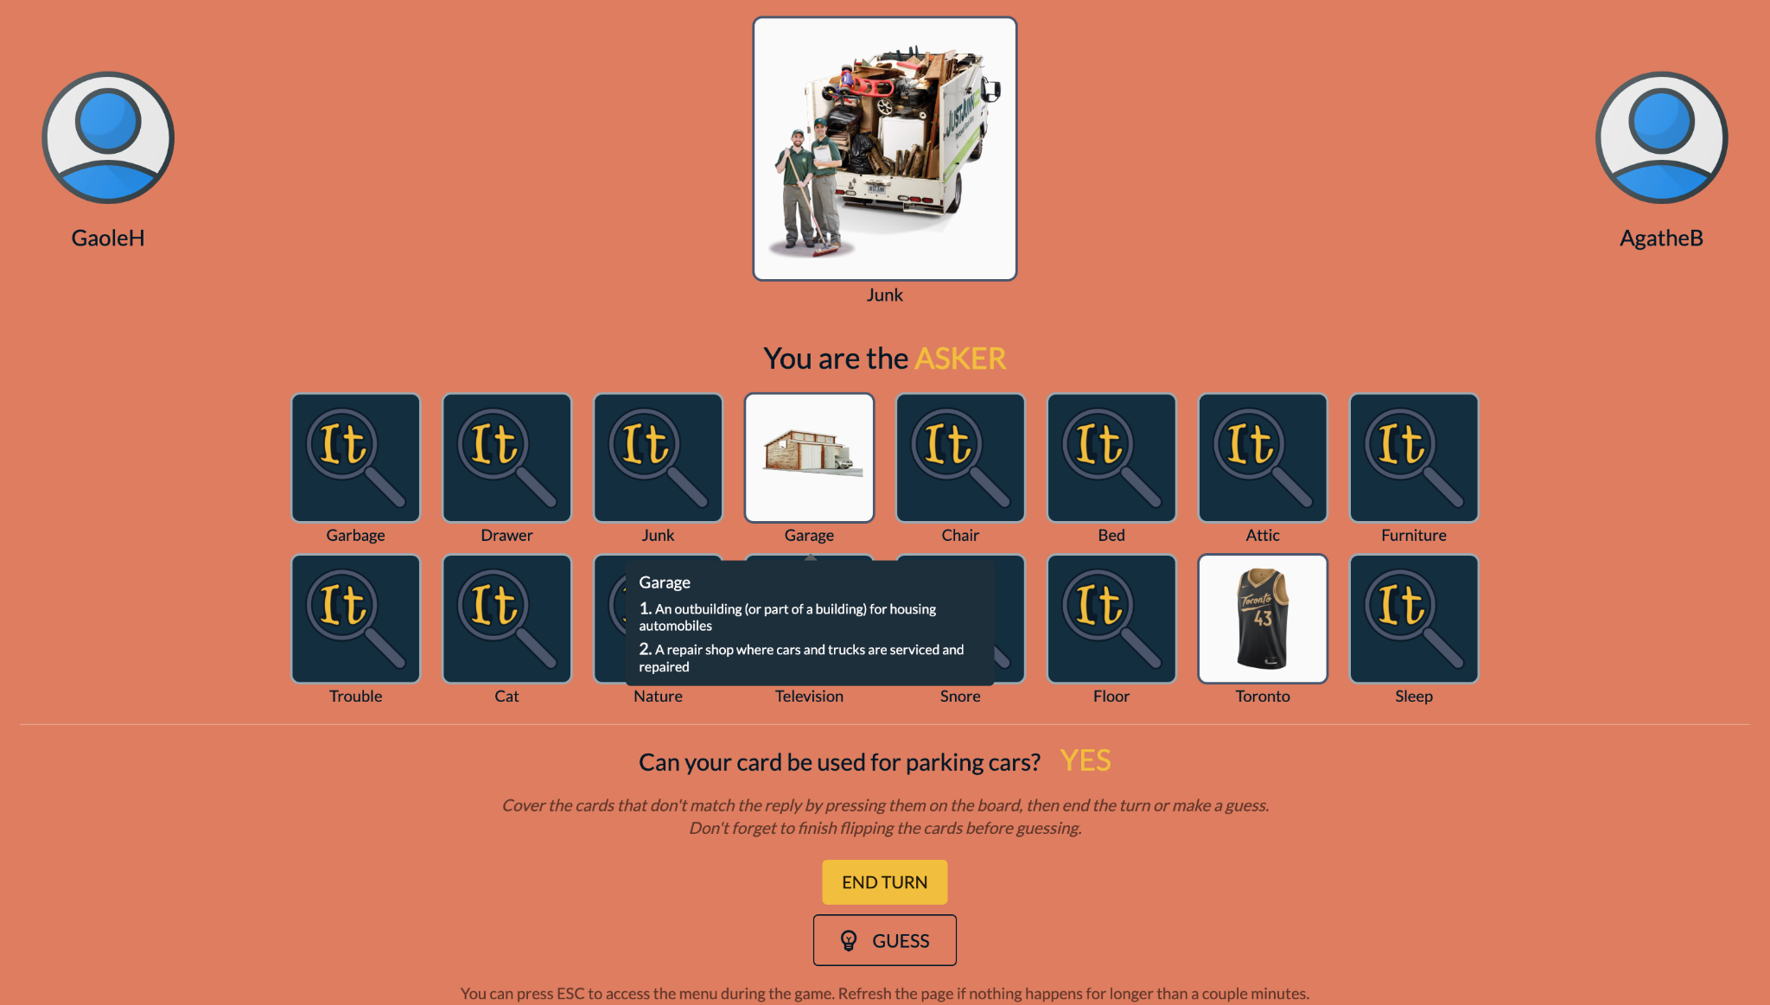
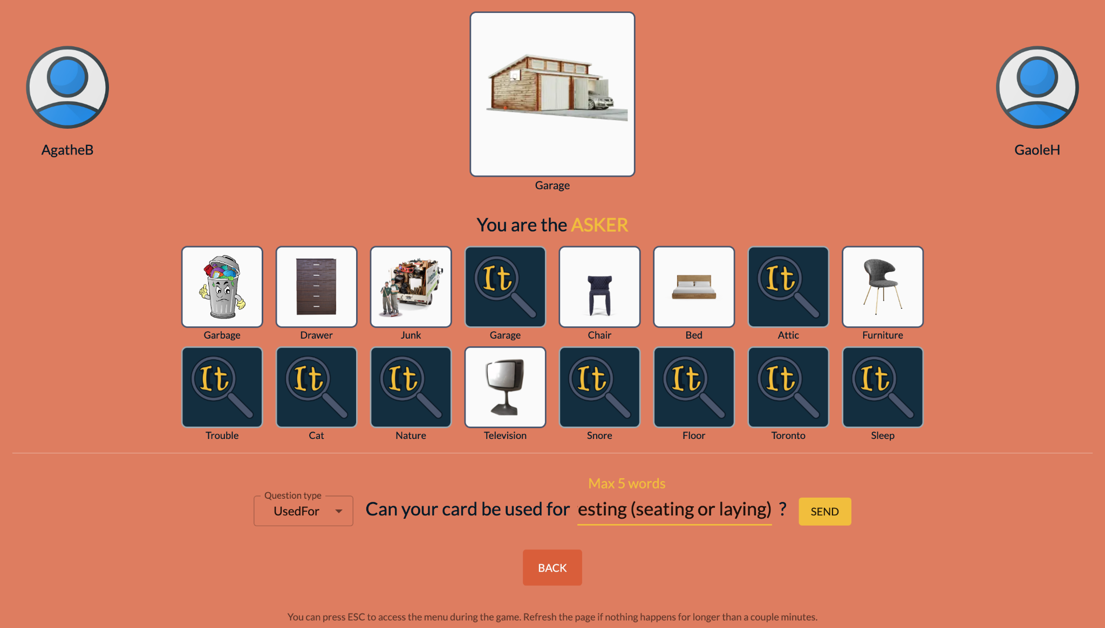
Quality Control & Mechanics
Reporting mistakes
Providing term definitions
Limiting type (taboo word) and number of words
Notes:
Just as we observed in pilot study, some players may cheat by misleading opponents with responding wrong answer.
After the game, each player can find any such cheating behaviors with reporting mistakes”.
To help players understand each concept, we provide definitions about each concept from wordnet when they hang their mouse on each card.
We also employ taboo words to ensure that the questions asked by the players are not too simple, and allow to extract useful knowledge.

Slide 17

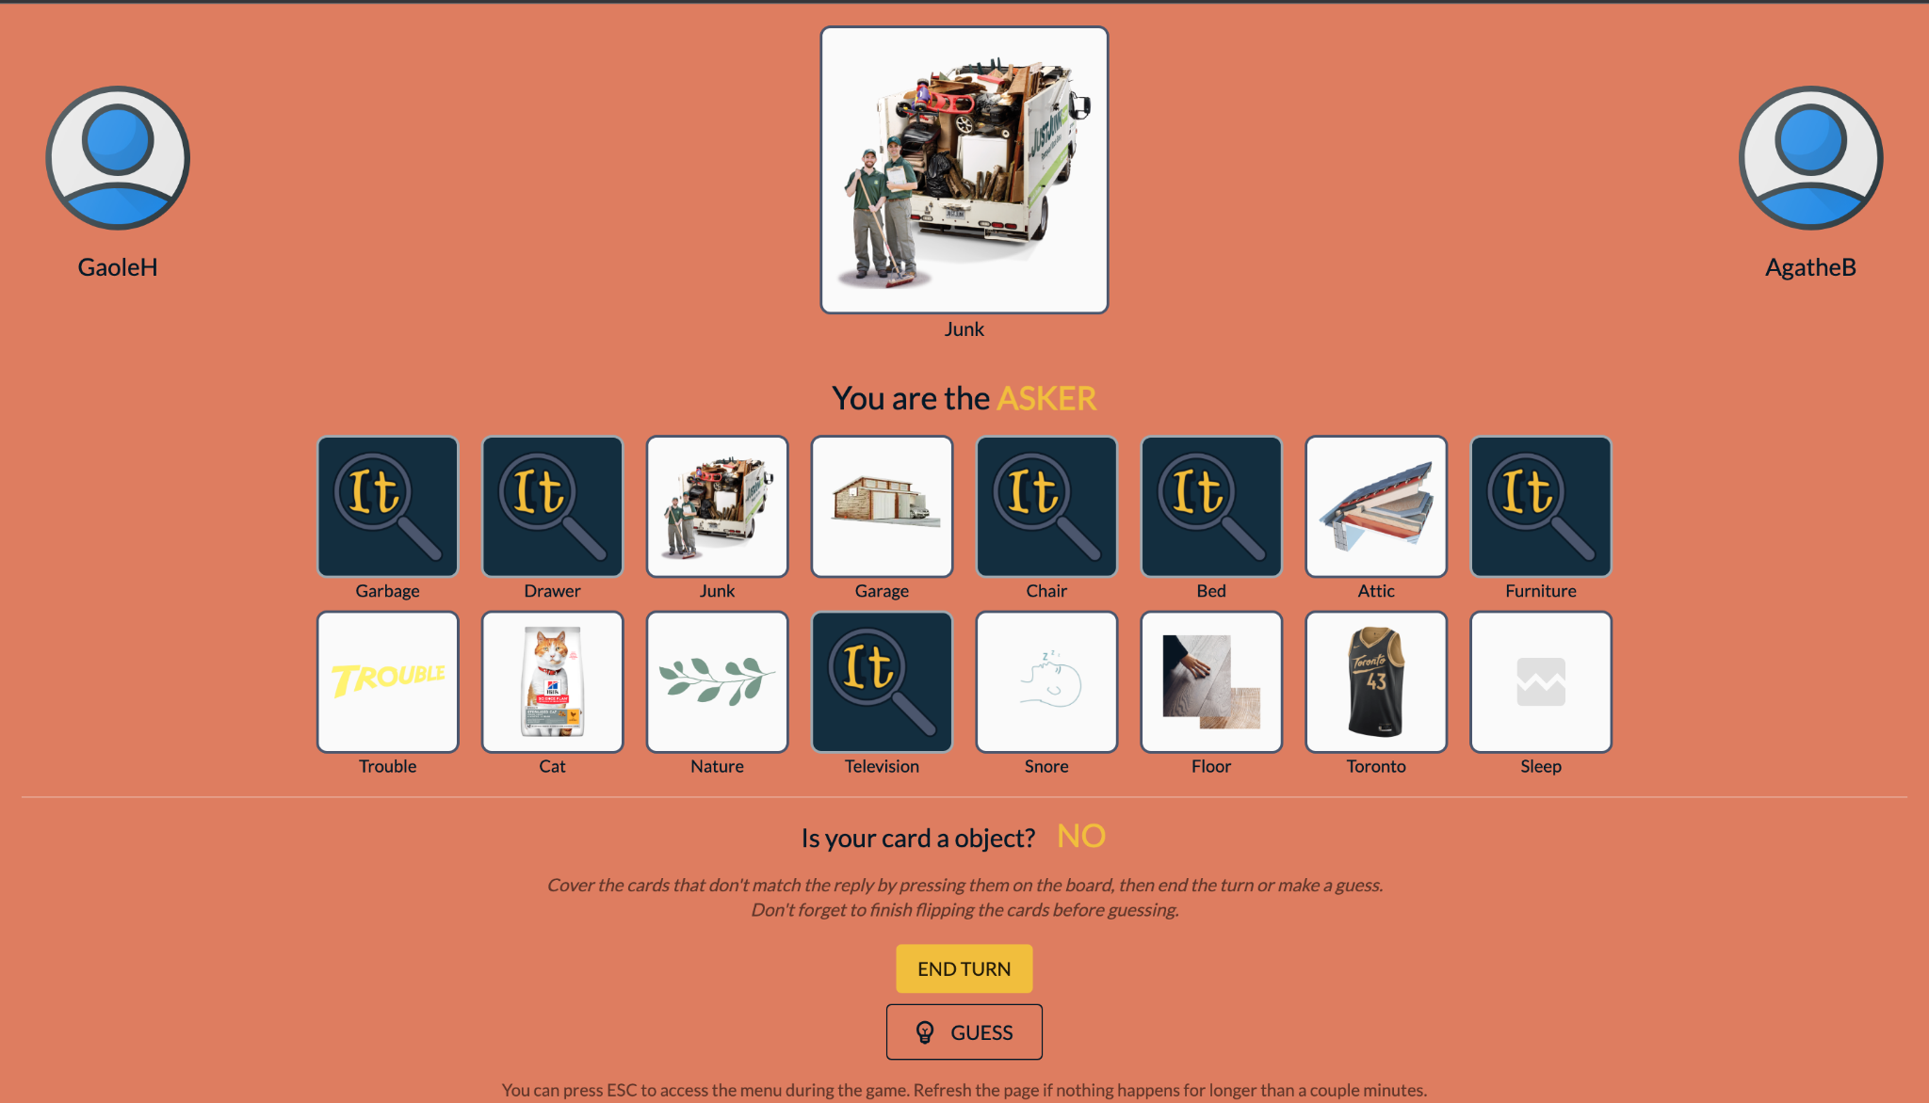
Knowledge Creation
Generative knowledge
+/- <concept, relation, input>
+<drawer, isA, object>
-<garage, isA, object>
Discriminative knowledge
+/- <concept#1, concept#2, relation, input>
-<drawer, television, isA, object>
+<drawer, garage, isA, object>
-<garage, attic, isA, object>
Notes:
We use this slide to illustrate the knowledge collection from player behaviors.
Given the question: is your card a object? And answer No.
The asker flip the card drawer means drawer is an object.
Meanwhile, the card garage is reserved unflipped, it indicates garage is not an object.
With card flipped and unflipped in the same turn, we can obtain discriminative knowledge
As drawer and television are both flipped in this turn, they can’t be distinguished with relational properties (isA, object).
It’s the same case for garage and attic which remained unflipped in this turn. With the same behaviors in this turn, we construct negative discriminative knowledge.
But when we consider the drawer, which is flipped this turn, and garage which keeps unflipped. We can draw positive discriminative knowledge as drawer and garage can be discriminated with relational properties (isA, object).

Slide 18

Empirical Evaluation &
Experiments
Notes:
Then, let’s move to the experimental evaluation about the collected knowledge.

Slide 19


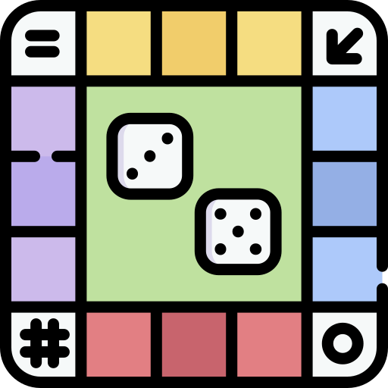
Experimental Setup
Knowledge collection:
Efficiency
Player experience
Collected knowledge:
Quality
Usefulness
Prolific workers
Qualitative Assessment
Common, iterative, qualitative coding
Discussion for reaching a consensus on the properties
2 sets of game boards
Discriminative Attributes
Commonsense QA
Notes:
In our experiment, we evaluate the knowledge collection process and the quality of collected knowledge.
All players are crowd workers hired from Prolific platform. The game boards are generated from two benchmarks of different tasks.
Namely discriminative attributes and commonsense question answering.
For the qualitative assessment, the authors followed an iterative coding process and discuss for the standard of each dimension to reach a consensus.

Slide 20
Results - Knowledge Collection
Quantity:
255 (164 easy, 91 difficult) for DA dataset, 75,491 knowledge tuples collected
242 (142 easy, 100 difficult) for CSQA dataset, 85,923 knowledge tuples collected
Easy games lasted 367.2s (SD=722.3) ---3.88 (SD=1.63) turns on average.
Difficult games lasted 397.5s (SD=201.4) ---5.69 (SD=1.98) turns on average.
Throughput:
13.9 tuples are generated per minute (per game), which is ten times more than Verbosity.
Utility
Difficult games correspond to a higher utility of FindItOut for the DA task, while easy games correspond to a higher utility for the CSQA task
Notes:
In our experiment, we have 255 games played for DA dataset, which collected around 75 thousand knowledge tuples
While 242 games played for commonsense question answering dataset, which collected around 86 thousand knowledge tuples.
On average, easy games lasted around 6 minutes, and players spend around 4 turns for each easy game.
Similarly, difficult games lasted 6.5 minutes, and players spend around 6 turns for each difficult game.
On average, the throughput is 13.9 tupes per minute per game for FindItOut, which is ten times more than existing methods Verbosity.
We also observe that: Difficult games correspond to a higher utility for the DA task, while easy games correspond to a higher utility for the CSQA task.
For more details about the knowledge collection evaluation, please refer to our paper.

Slide 21
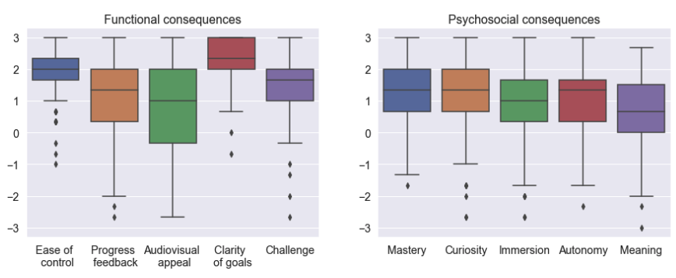
Results - Knowledge Collection
Player experience
On average, functional consequences > 1 (scale -3 ~ 3)
On average, psychosocial consequences > 0 (scale -3~3)
Players enjoyed the game
Game piqued their curiosity
Notes:
Based on our findings from the player experience questionnaire, the main functionalities of FindItOut were well understood and appreciated by players.
On average players rated the functional consequences (which indicates “the immediate experiences as a direct result of game design choices”) with >1 on a scale of -3 to 3.
These highly-rated functional consequences translated into highly rated psychosocial consequences as well, with an average rating per dimension always above 0.
This shows that FindItOut was enjoyed by players, piqued their curiosity by prompting them to think of topics (differences between concepts) that they probably do not typically think of.

Slide 22
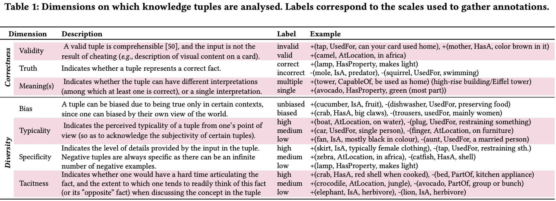
Results - Knowledge Quality
Qualitative evaluation dimensions
7 dimensions, two main category
Notes:
To assess the quality of collected knowledge tuples, we defined 7 dimensions which fall into the category of correctness and diversity.
Zoom into every dimension, we find that most generative tuples collected are meaningful, correct and unbiased.
And we also find the collected knowledge tuples have a relatively highly tacit and specific knowledge, while also a small ratio of typical knowledge.
These findings confirm that FindItOut allow for externalizing tacit knowledge, that is typically not found in existing knowledge bases.

Slide 23
Results - Usefulness for AI Tasks
Usefulness for DA:
28.8% of reference triples covered
All potential concept pairs covered, which goes beyond the scope of DA dataset
Usefulness for CSQA:
2.82 / 5 choice find relevant knowledge tuples
0.52 / 5 choice find useful knowledge tuples (correct and can confirm the answer or discard a distraction term)
Notes:
To assess the usefulness of knowledge collected for discriminative attribute dataset, we calculate the coverage of reference triples to create the game boards.
In our experiment, 28.8% of triples are covered. Meanwhile, all potential concept pairs of the discriminative attributes are covered, which goes beyond the scope of original dataset.
For the commonsense question answering dataset, we manually annotated the relevance and usefulness for each question.
For each question, we retrieve top-5 relevant knowledge tuples generated with semantic similarity. The results show that, more than half of choices in each question can find relevant knowledge tuples.
And around 10% choice can find useful knowledge, which can directly confirm the answer or discard a distraction term.

Slide 24
Conclusions
Contribution
A GWAP: A novel configurable GWAP to collect plural knowledge types at scale
A methodology: knowledge characterization
A study of our GWAP’s performance
Qualitative study of crowdsourced knowledge
Quantitative study of the throughput and utility for two AI tasks
Avenues for future work
Knowledge post-processing for increased quality
Game board population
Use on subsequent AI tasks
Notes:
In conclusion.
Mainly, this work have following contribution:
First, we designed a novel configurable game with a purpose FindItOut, which can collect plural commonsense knowledge at scale.
Secondly, we provide a structured set of dimensions for knowledge characterization.
Thirdly, we conduct an empirical study about the performance of FindItOut based on crowd workers.
Furthermore, we conduct qualitative study of collected knowledge tuples and quantitative study of the efficiency of knowledge collection process
In the future, we will also consider:
(1) improve the quality of collected knowledge with post-processing, such as redundancy
(2) The generation of game boards largely affect the collected knowledge, we’ll also explore how to generate more meaningful game boards based on efficiency, quality and player experience.
(3) We may explore to use the plural knowledge tuples collected from FindItOut on downstream tasks.

Slide 25
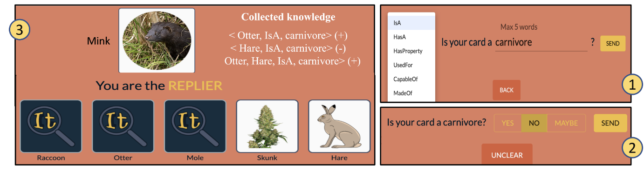

Thank you for your attention!
Takeaways:
FindItOut: a configurable GWAP
Knowledge collection at scale
Plural knowledge types
Characterisation of diversity for crowdsourced knowledge
Play our game at:
https://finditout.vercel.app/
Code Available:
https://github.com/delftcrowd/FindItOut
Gaole He, g.he@tudelft.nl
Agathe Balayn, a.m.a.balayn@tudelft.nl
Notes:
Thanks for your time and listening! For more details about our game FindItout you can refer to our paper.
Meanwhile, our demo and code is available.

Slide 26
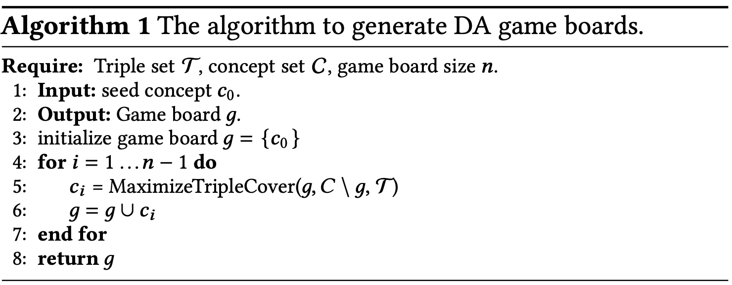
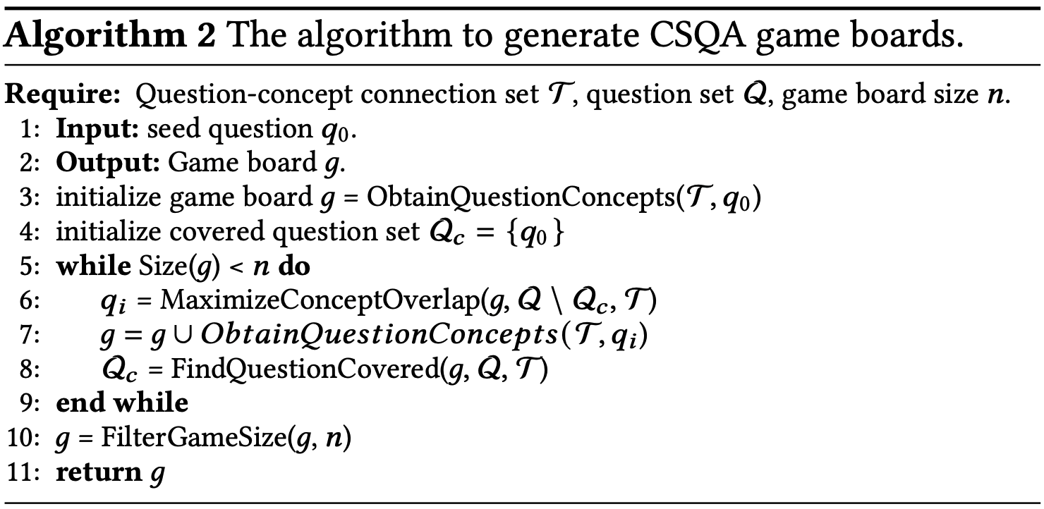
Game Boards Generation
Greedy Search Strategy
Find most similar/relevant concepts for each game board

Slide 27
Results - Knowledge Quality
86.3% tuples unbiased,
38.3% highly tacit (21.3% medium),
57.5% highly specific (16.9% medium), 7.98% atypical
95.6% of the generative tuples elicited are meaningful. Among these, 90.6% of the tuples are correct. 76.2% of the discriminative tuples elicited are correct. (Verbosity reports 85% of correct generative tuples).
Notes:
Zoom into every dimension, we find that most generative tuples collected are meaningful, correct and unbiased.
And we also find the collected knowledge tuples have a relatively highly tacit and specific knowledge, while also a small ratio of typical knowledge.
These findings confirm that FindItOut allow for externalizing tacit knowledge, that is typically not found in existing knowledge bases.
There exist disagreement on dimensions like bias, typicality.
The disagreement here is due to the subjectivity of the task: knowledge and the veracity of a fact vary depending on one’s own experience of the world

